Slide 1
SHOP FOR HOME CAPSTONE PROJECT
MEMBERS:
Thara T
Gowsiga K
Swarnamala Gandra
Sanjana Kanavi
Suraksha Shetty
Shubham Acharekar
MENTOR:
Mr. Parth Shukla

Slide 2
Problem Statement:
ShopForHome is a popular Store in the market for shopping the home décor stuff. Due to Covid 19 all the offline shopping stopped. So, the store wants to move to the cloud platforms and wants their own web application.

Slide 3
User Stories:
As a user I should be able to login, Logout and Register into the application.
As a user I should be able to see the products in different categories.
As a user I should be able to sort the products.
As a user I should be able to add the products into the shopping cart.
As a user I should be able to increase or decrease the quantity added in the cart.
As a user I should be able to add “n” number of products in the cart.
As a user I should be able to get the Wishlist option where I can add those products which I want but don’t want to order now.
As a user I should get different discount coupons.

Slide 4
Admin Stories:
As an Admin I should be able to login, Logout and Register into the application.
As an Admin I should be able to perform CRUD on Users.
As an Admin I should be able to Perform CRUD on the products.
As an Admin I should be able to get bulk upload option to upload a csv for products details.
As an Admin I should be able to get the stocks.
As an Admin I should be able to mail if any stock is less than 10.
As an Admin I should be able to get the sales report of a specific duration.
As an Admin I should be able to set the discount coupons for the specific set of users

Slide 5
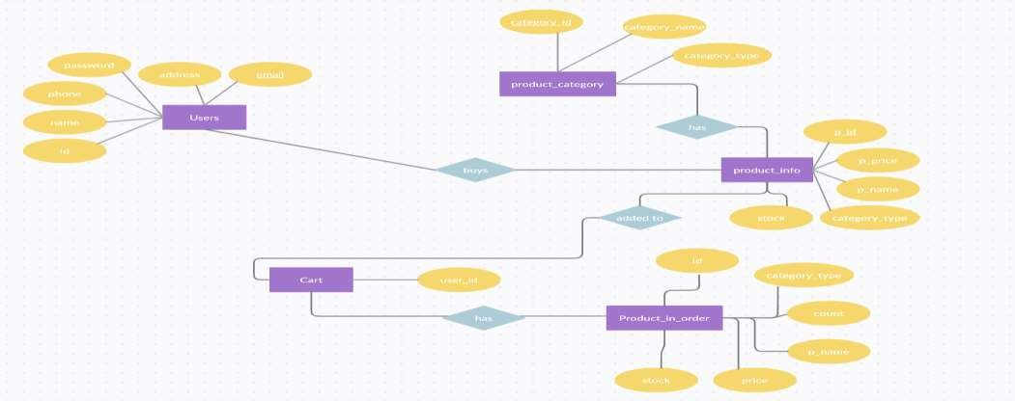
ENTITY RELATIONSHIP DIAGRAM:
The Entity relation ship diagram displays the relationships between the entities that are stored in database.
The figure 1 represents the ER diagram of our Shop For Home application.
Figure 1: ER Diagram for ShopForHome

Slide 6
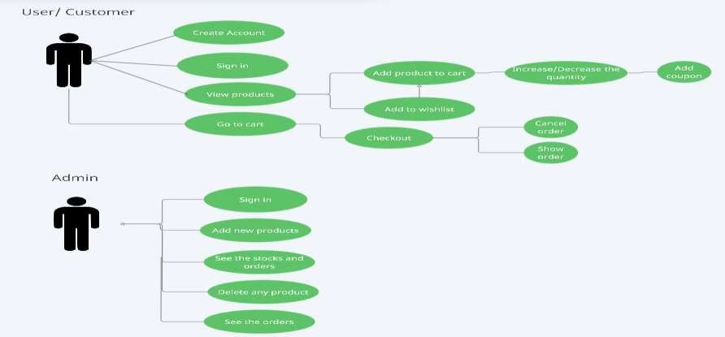
USE CASE DIAGRAM:
A Use case diagram is a way to summarize the details of the system and the users within that system.
The figure 2 represents the use case diagram of our Shop For Home application.
Figure 1: Use Case Diagram for ShopForHome

Slide 7
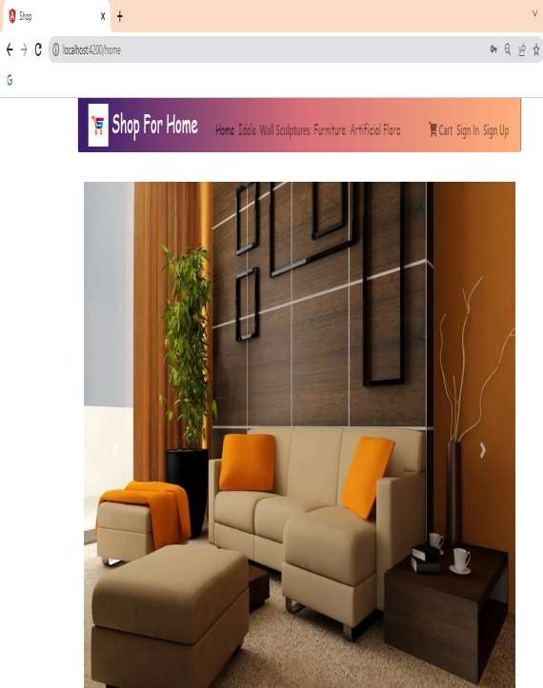
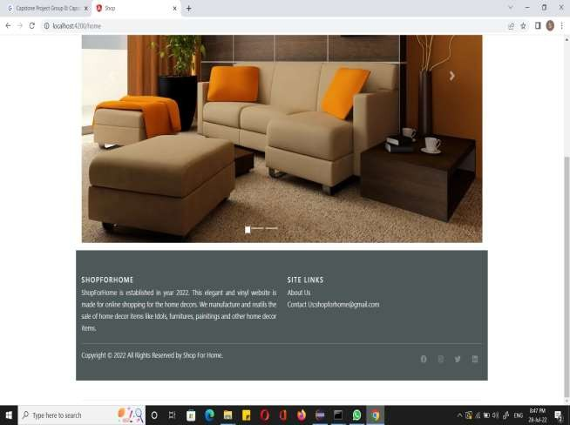
Home Page

Slide 8
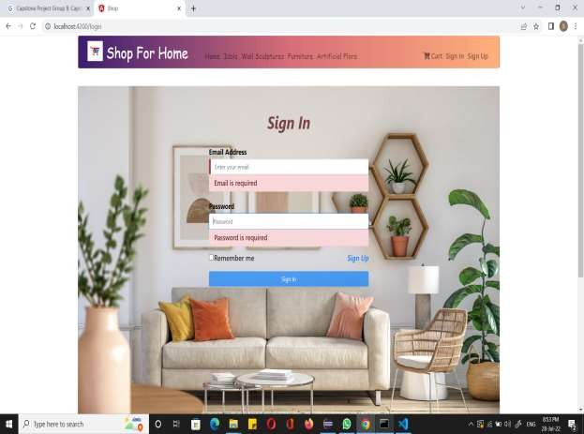
Sign In

Slide 9
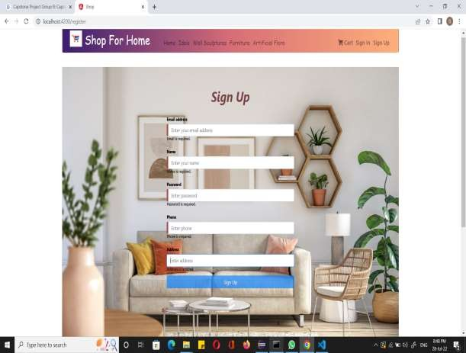
Sign Up

Slide 10
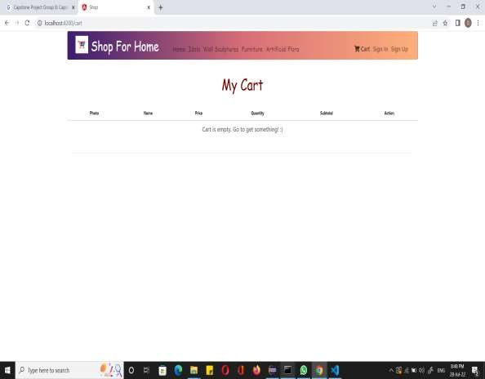
Cart Option

Slide 11

Orders

Slide 12
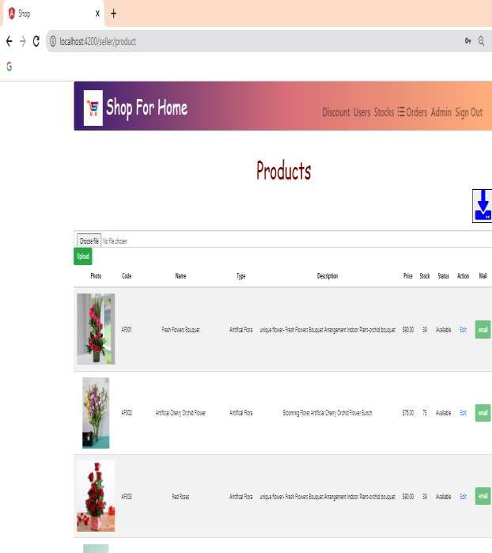
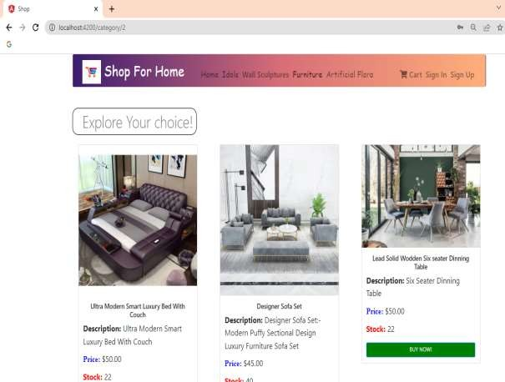
Products

Slide 13


